Slide 1
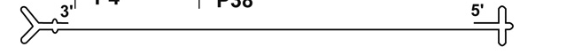
A
P4
P38
3’
NS1 / NS2
VP1 / VP2
5’
ORFs
Non-structural ORF
Structural ORF
1
0
kb
1
2
3
4
5
5.1
2
3
0
m. u.
25
50
75
100
B
Transcripts
Proteins
kDa
D1
A2
D2
A1
R1 M, m, r
AAAAA
NS1
3
83
large intron
small intron
R2 M
3
2
2
AAAAA
NS2^{P}
25
R2 m
2
AAAAA
NS2^{Y}
3
25
R2 r
3
2
2
AAAAA
NS2^{L}
25
VP1u
capsid shell
R3 m
3
AAAAA
VP1
1
83
R3 M, r
1
AAAAA
VP2
64
R2 M, m, r
AAAAA
SAT
2
6
poly(G)

